Slide 1
ALGORITHMS AND FLOWCHARTS
Computer programming can be divided into two phases:
Problem solving phase
  Make an ordered sequence of steps that solves a problem
  these sequence of steps is called an algorithm
Implementation phase
  implement using a programming language

Slide 2
Steps in Problem Solving
First produce a general algorithm (one can use pseudocode)
Refine your steps until you get to an easy sequence. Perhaps use numbers or bullets. The point is to simplify.
Pseudocode is an artificial and informal language that helps programmers develop algorithms. Pseudocode may be an informal english, combinations of computer languages and spoken language. Whatever works for you.

Slide 3
Pseudocode & Algorithm
Example 1:
Write an algorithm to determine a student’s final grade and indicate whether it is passing or failing. The final grade is calculated as the average of four marks.

Slide 4
Pseudocode & Algorithm
Pseudocode:
Input a set of 4 marks
Calculate their average by summing and dividing by 4
if average is below 60
Print “FAIL”
else
Print “PASS”

Slide 5
Pseudocode & Algorithm
Detailed Algorithm
Step 1: Input M1,M2,M3,M4
Step 2: GRADE ← (M1+M2+M3+M4)/4
Step 3: if (GRADE < 60) then
Print “FAIL”
else
Print “PASS”
endif

Slide 6
The Flowchart
A Flowchart is another algorithm but graphical.
  shows logic solution
  emphasizes individual steps and their interconnections
  A flowchart must have a start and stop
  A steps in a flowchart must connect. Can’t leave a step “hanging” with no connection.
  e.g. control flow from one action to the next

Slide 7
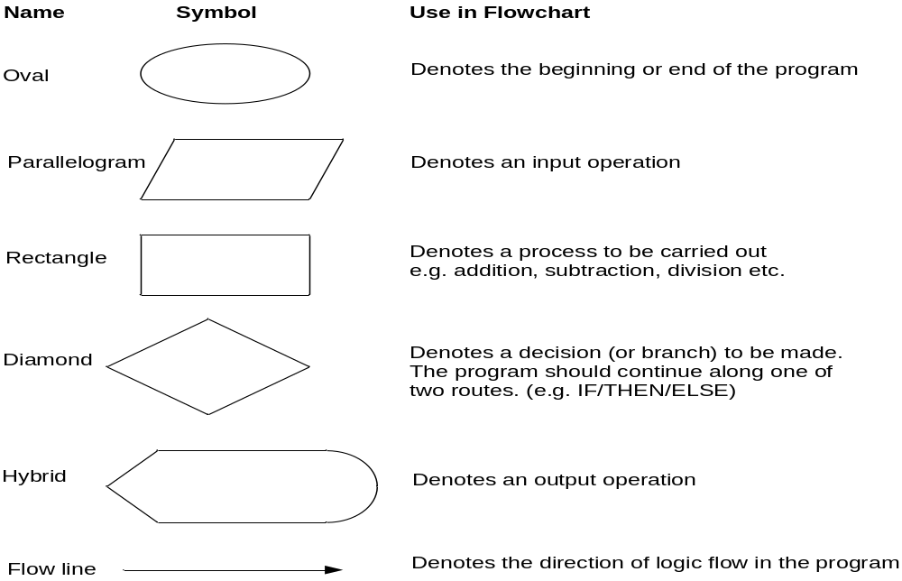
Flowchart Symbols
General Used Symbols

Slide 8
Example
START
Step 1: Input M1,M2,M3,M4
Step 2: GRADE ← (M1+M2+M3+M4)/4
Step 3: if (GRADE < 60) then
Print “FAIL”
else
Print “PASS”
endif
Input
M1,M2,M3,M4
GRADE←(M1+M2+M3+M4)/4
IS
GRADE<60
N
Y
PRINT
“PASS”
PRINT
“FAIL”
STOP

Slide 9
Example 2
Write an algorithm and draw a flowchart to convert the length in feet to centimeter.
Pseudocode:
Input the length in feet (Lft)
Calculate the length in cm (Lcm) by multiplying LFT with 30
Print length in cm (LCM)

Slide 10
Example 2
Flowchart
Algorithm
Step 1: Input Lft
Step 2: Lcm ← Lft x 30
Step 3: Print Lcm
START
Input
Lft
Lcm ← Lft x 30
Print
Lcm
STOP

Slide 11
Example 3
Write an algorithm and draw a flowchart that will read the two sides of a rectangle and calculate its area.
Pseudocode
Input the width (W) and Length (L) of a rectangle
Calculate the area (A) by multiplying L with W
Print A

Slide 12
Example 3
Algorithm
Step 1: Input W,L
Step 2: A ← L x W
Step 3: Print A
START
Input
W, L
A ← L x W
Print
A
STOP

Slide 13

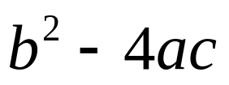
Example 4
Write an algorithm and draw a flowchart that will calculate the roots of a quadratic equation
Hint: d = sqrt ( ), and the roots are: x1 = (–b + d)/2a and x2 = (–b – d)/2a

Slide 14
Example 4
Pseudocode:
Input the coefficients (a, b, c) of the quadratic equation
Calculate d
Calculate x1
Calculate x2
Print x1 and x2

Slide 15

Example 4
START
Algorithm:
Step 1: Input a, b, c
Step 2: d ← sqrt ( )
Step 3: x1 ← (–b + d) / (2 x a)
Step 4: x2 ← (–b – d) / (2 x a)
Step 5: Print x1, x2
Input
a, b, c
d ← sqrt(b x b – 4 x a x c)
x₁ ←(–b + d) / (2 x a)
X₂ ← (–b – d) / (2 x a)
Print
x₁ ,x₂
STOP

Slide 16
DECISION STRUCTURES
The expression A>B is a logical expression
it describes a condition we want to test
if A>B is true (if A is greater than B) we take the action on left
print the value of A
if A>B is false (if A is not greater than B) we take the action on right
print the value of B

Slide 17
DECISION STRUCTURES
is
A>B
Y
N
Print A
Print B

Slide 18
IF–THEN–ELSE STRUCTURE
The structure is as follows
If condition then
true alternative
else
false alternative
endif

Slide 19
IF–THEN–ELSE STRUCTURE
The algorithm for the flowchart is as follows:
If A>B then
print A
else
print B
endif
is
A>B
Y
N
Print A
Print B

Slide 20
Relational Operators
Relational Operators
Operator | Description
> | Greater than
< | Less than
= | Equal to
≥ | Greater than or equal to
≤ | Less than or equal to
≠ | Not equal to

Slide 21
Your flowchart
Write an algorithm that reads two values, determines the largest value and prints the largest value with an identifying message.
ALGORITHM
Step 1: Input VALUE1, VALUE2
Step 2: if (VALUE1 > VALUE2) then
MAX ← VALUE1
else
MAX ← VALUE2
endif
Step 3: Print “The largest value is”, MAX

Slide 22
Example 5
START
Input
VALUE1,VALUE2
Y
is
VALUE1>VALUE2
N
MAX ← VALUE1
MAX ← VALUE2
Print
“The largest value is”, MAX
STOP

Slide 23
nested if statements
One of the alternatives within an
IF–THEN–ELSE statement
  may involve further IF–THEN–ELSE statement

Slide 24
Example 6
Write an algorithm that reads three numbers and prints the value of the largest number.

Slide 25
Example 6
Step 1: Input N1, N2, N3
Step 2: if (N1>N2) then
if (N1>N3) then
MAX ← N1 [N1>N2, N1>N3]
else
MAX ← N3 [N3>N1>N2]
endif
else
if (N2>N3) then
MAX ← N2 [N2>N1, N2>N3]
else
MAX ← N3 [N3>N2>N1]
endif
endif
Step 3: Print “The largest number is”, MAX

Slide 26
Example 6
YOUR JOB
Flowchart: Draw the flowchart of the previous algorithm.

